Slide 1

Airborne Vehicle Health Parameter Monitoring System in Java using GLG Toolkit
Presented by:
Shubhrajyoti Das
Viswajeet Ray
Udit Narayan Ray
Mentor- Dr. Sourav Kaity, Scientist ’F’
ITR-DRDO
ITR-DRDO
Notes:
Add guide name

Slide 2
Introduction
A software application which aims to provide real-time monitoring, visualization and analysis of parameters of airborne vehicles.
Ensures safe and efficient operation of airborne vehicles.
This system monitors 3 basic parameters: Velocity, Pressure, Voltage

Slide 3
Defence Research And Development Organisation (DRDO)
R&D wing of Ministry of Defence, Government of India.
Mission to achieve self-reliance in defence technologies and systems.
Achievements include:
Agni & Prithvi : missile series
Tejas : light combat aircraft
Akash : air defence system, etc.
Motto: ‘Balasya Mulam Vigyanam’ - Source of strength is Science.

Slide 4
Integrated Test Range (ITR)
Well equipped Test and Evaluation (T&E) centre of DRDO.
Provides safe and reliable launch facilities for rockets, missiles and other airborne weapon systems.
Deploys high-performance range instrumentation systems: EOTS, Radar system, Telemetry, Control centre etc.

Slide 5
Java And Its Significance
Widely used programming language developed by Sun Microsystems.
Platform independent language.
Code can run on any platform with a JVM (Java Virtual Machine) installed.
Common applications include:
Web development
Mobile app development
Desktop GUI applications
Big data processing, etc.

Slide 6
Software Requirement Specification (SRS)
Non-Functional Requirements:
System specifications
Should support commonly used OS, such as Windows, Linux etc.
Should have sufficient hardware resources to run java programs i.e., RAM and storage space, etc.
Should have appropriate version of JDK, IDE and JRE installed.
Toolkit requirements
GLG Toolkit for graphical representation of the obtained parameters.
It is a software library developed by Generic Logic Inc. for creating interactive and data-driven graphical displays.
Provides a set of tools for developing high-performance applications for defence systems.
Provides range of APIs and libraries for integrating with other languages and frameworks.

Slide 7
Non-Functional Requirements:
Protocol
The application should utilize the User Datagram Protocol (UDP).
UDP ensures minimum latency, fast and reliable communication.
IP Addressing
The system should be compatible with IPv4 addressing.
Security
The application should maintain confidentiality, integrity and availability of information.
Interoperability
The application should support interoperability with other defence systems and tools.

Slide 8
Functional Requirements:
The application should be Thread-based.
List of functions defined in the GLG Graphics Builder program:
i. Constructor for the main class initializing Datagram Socket
ii. javax.swing.*
iii. SetDResource()
iv. Timer()
v. update()
vi. UpdateMeter()
vii. actionPerformed()
viii. Start()

Slide 9
Feasibility Study:
Technical Feasibility:
UDP is suitable for real-time applications with low overhead and fast transmission.
Java GUI builder enables effective visualization and analysis of tracked missile data.
Operational Feasibility:
We gather and analyze user requirements from defense analysts.
Provide training and support to users.
Ensure compatibility and integration with existing systems in ITR.

Slide 10
Feasibility Study:
Economic Feasibility:
Costs for hardware, software, development resources, maintenance, and licensing are feasible.
Legal and Ethical Feasibility:
Ensure compliance with legal and regulatory requirements.
Address restrictions on accessing real-time missile data and ensure data confidentiality.
Assess ethical implications and implement protocols to mitigate risks.
Overall Feasibility Assessment:
UDP-based real-time missile data tracking and graphical representation system is feasible.

Slide 11
Design/Coding
All coding is done in Java using Visual Studio Code.
Programming Language used- All coding is done in Java.
Development Environment Used
Java Development Kit (JDK).
Java Runtime Environment (JRE) to run & test the application during the dev process.
Integrated Development Environment (IDE): Visual Studio Code.
Toolkit Used Used - GLG Toolkit for visualizations (including dial, gauge, and graphs).

Slide 12
Functional Design for UDP Sender program:
Package and Library imports: java.net, java.util and java.io
GlgSendData class:
GlgSendData class reads data from database and transfers it using UDP.
An `InetAddress` object named `ip` is created representing the IP address “127.0.0.1”.
A `DatagramSocket` object named `ds` is created which represents a UDP socket .
A `DatagramPacket` object named `dp` is created that encapsulates the byte array representation of the string `str`.
`ds.send(dp);` sends the `dp` packet through the `ds` socket to the specified IP address and port.

Slide 13
Functional Design for GLG Real-Time Graphics program:
Package & Library imports: import com.genlogic.*, java.awt, java.net, java.util, java.io, javax.swing .
Functions Arrays & Variables:
Setting up GUI Window using .SetDrawingName( "meter.g" );
UpdateMeter() to establish socket connection.
vel, pre, vol, velgraph, pregraph, volgraph.
SetDResource("vel/Value",vel);
animation_array[0]= new GlgAnimationValue(this,GlgAnimationValue.SIN,0,2,vel,vel,"velgraph/Value”);
So, these commands help update the data in real time in the GLG GUI file ‘meter.g’

Slide 14
G U I
GUI stands for Graphical User Interface.
GUI is a visual interface that allows users to interact with software or electronic devices.
GUI simplifies user interactions and reduce the need for specialized technical knowledge.
GUI has made technology more accessible and user-friendly for a broader range of users.
GUI found in OS, software or mobile apps, and consumer electronics.

Slide 15
User Interface Design
2 Meters , 1 Gauge and 3 Graphs Used.
Each Meter/ Dial used for Velocity, Pressure and gauge for Voltage.
Each Graph used for Velocity-Time, Pressure-Time and Voltage-Time.
All GUI Units Grouped Together within Panel in GLG Toolkit.
Single Panel Named as “ $Widget ”.

Slide 16
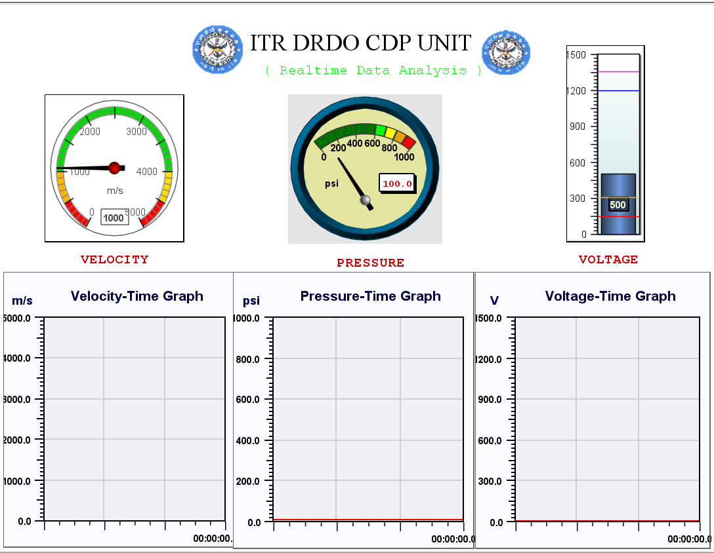
Design Layout

Slide 17
Testing
Testing parameters(v,p,V) were stored in file.
Total 100 inputs were taken.
100 inputs were send as real time values using UDP.
These 100 inputs were received one by one and shown accordingly in respective elements.
Meter used for velocity, pressure and gauge for voltage.

Slide 18
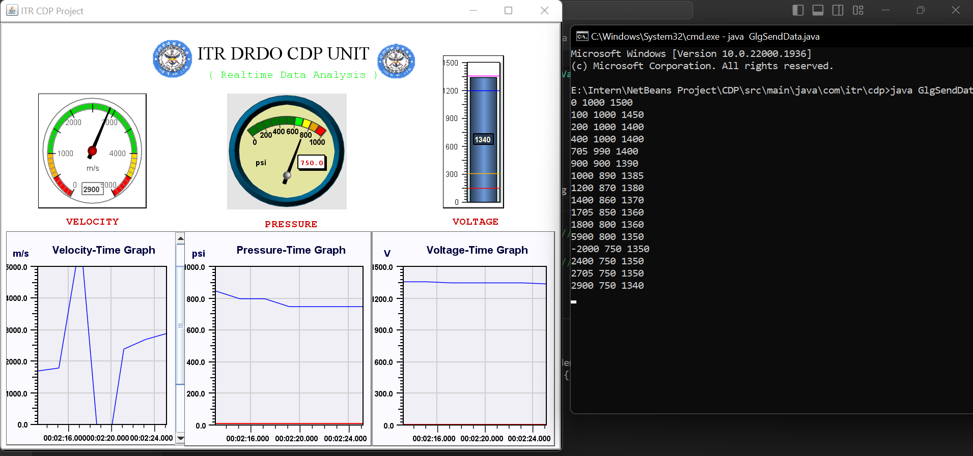

Slide 19
Test Case
All output generated corresponding to sample input.
Fixed scaling and no variable scaling.
Real time plotting and pointing of values.
After sometime, past value are not displayed on screen.
Plotting of range values on graph were by linear line not by the curve.

Slide 20
Future Scope
We can monitor more Parameters as per requirement.
We can add feature for screen recording to record the simulation.
Introduction of replay feature.
Switching between the real time values and past values simulation.

Slide 21
Thank You :)

